Slide 1


Titolo presentazione sottotitolo
Dimensions of AI-enabled Mobile and Embedded Devices: an Integration Design Guide
Marco Fasanella 10617541
Milano, XX mese 20XX
Relatore: Prof. Cinzia Cappiello
Co-relatore: Prof. Giacomo Boracchi

Slide 2
Motivation and goals
Problems:
Need of a complete overview of the aspects and methodologies used in resource-constrained devices
Despite the rich literature, little has been done regarding a pragmatic approach to the problem
Objectives:
Define the most relevant aspects of AI on resource-constrained devices and formalize them in Dimensions
Develop a graphical tool to identify the best suited deployment type to use
1

Slide 3
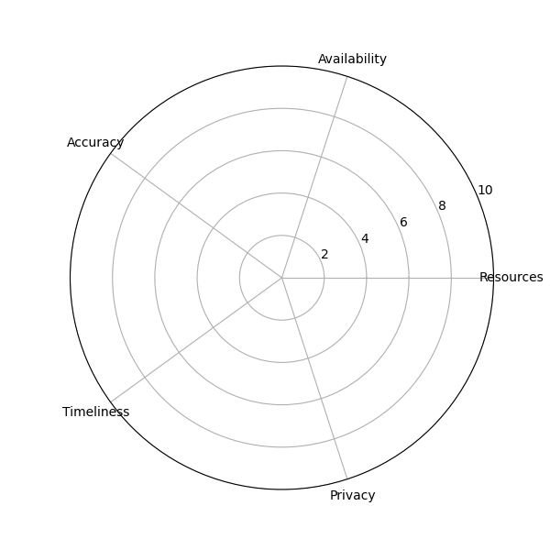
The 5 Dimensions
We can define the 5 dimensions di of AI in resource-constrained devices:
d1: Resources
d2: Availability
d3: Accuracy
d4: Timeliness
d5: Privacy
Assigning a Score from 0 to 10 to each di, leading to a resulting point:
p=(d1,d2,d3,d4,d5)
and its centroid.
Radar Chart
2

Slide 4
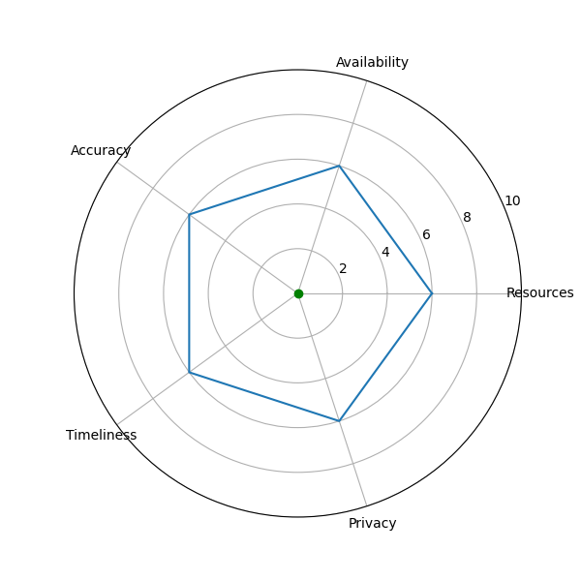
The 5 Dimensions
The centroid purpose is to highlight which are the dominant dimensions
Then based on its position on the radar chart, it will suggest which deployment fits best
p=(6,6,6,6,6)
Example Point and its centroid
3

Slide 5
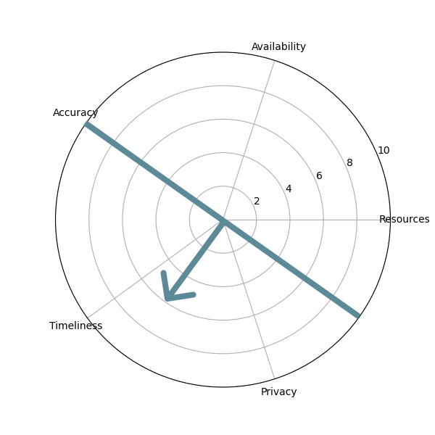
Local Deployment
Centroid positioning on
bottom-left part:
Timeliness
Privacy
Availability
Resources
Limitations: The issues of DNN, Capacity and Battery Lifetime
Relief: Parameter Pruning, Model Distillation and
Low-Rank Factorization
Local positioning on Radar Chart
4

Slide 6
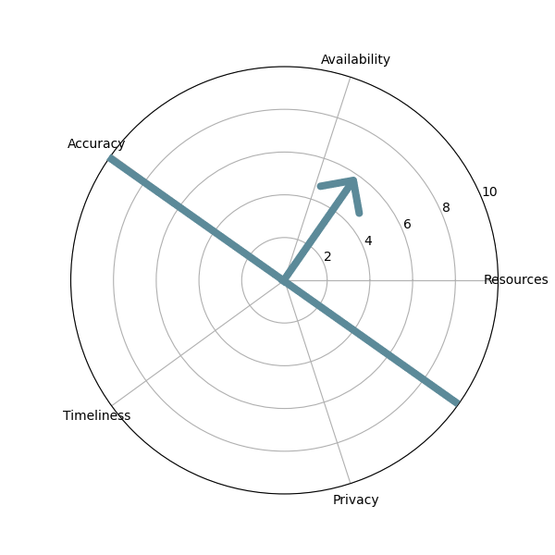
Distributed Deployment
Centroid positioning on
upper-right part:
Availability
Resources
Timeliness
Privacy
Limitations: Dynamic Conditions,
Privacy Issue and QoS
Relief: Anonymization Techniques,
5G, AI supported Networks and
Mobile Edge Computing (MEC)
Distributed positioning on Radar Chart
5

Slide 7
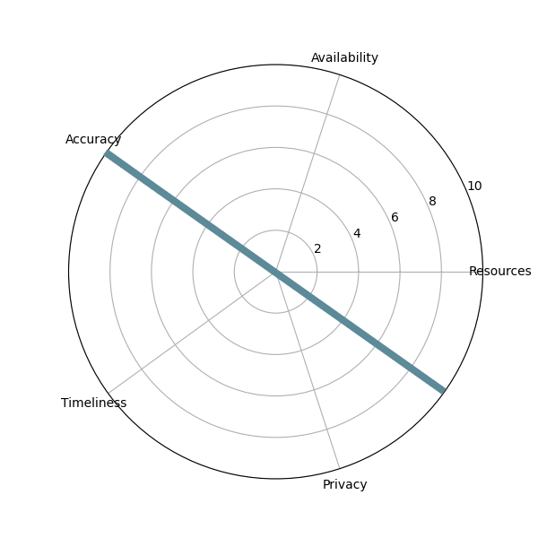
Hybrid Deployment
Centroid positioned nearby the separation line.
The separation line is the separator between local and distributed deployment
Task Partitioning
Privacy and Security
Network Conditions
User Experience
Resource Optimization
Hybrid positioning on Radar Chart
6

Slide 8
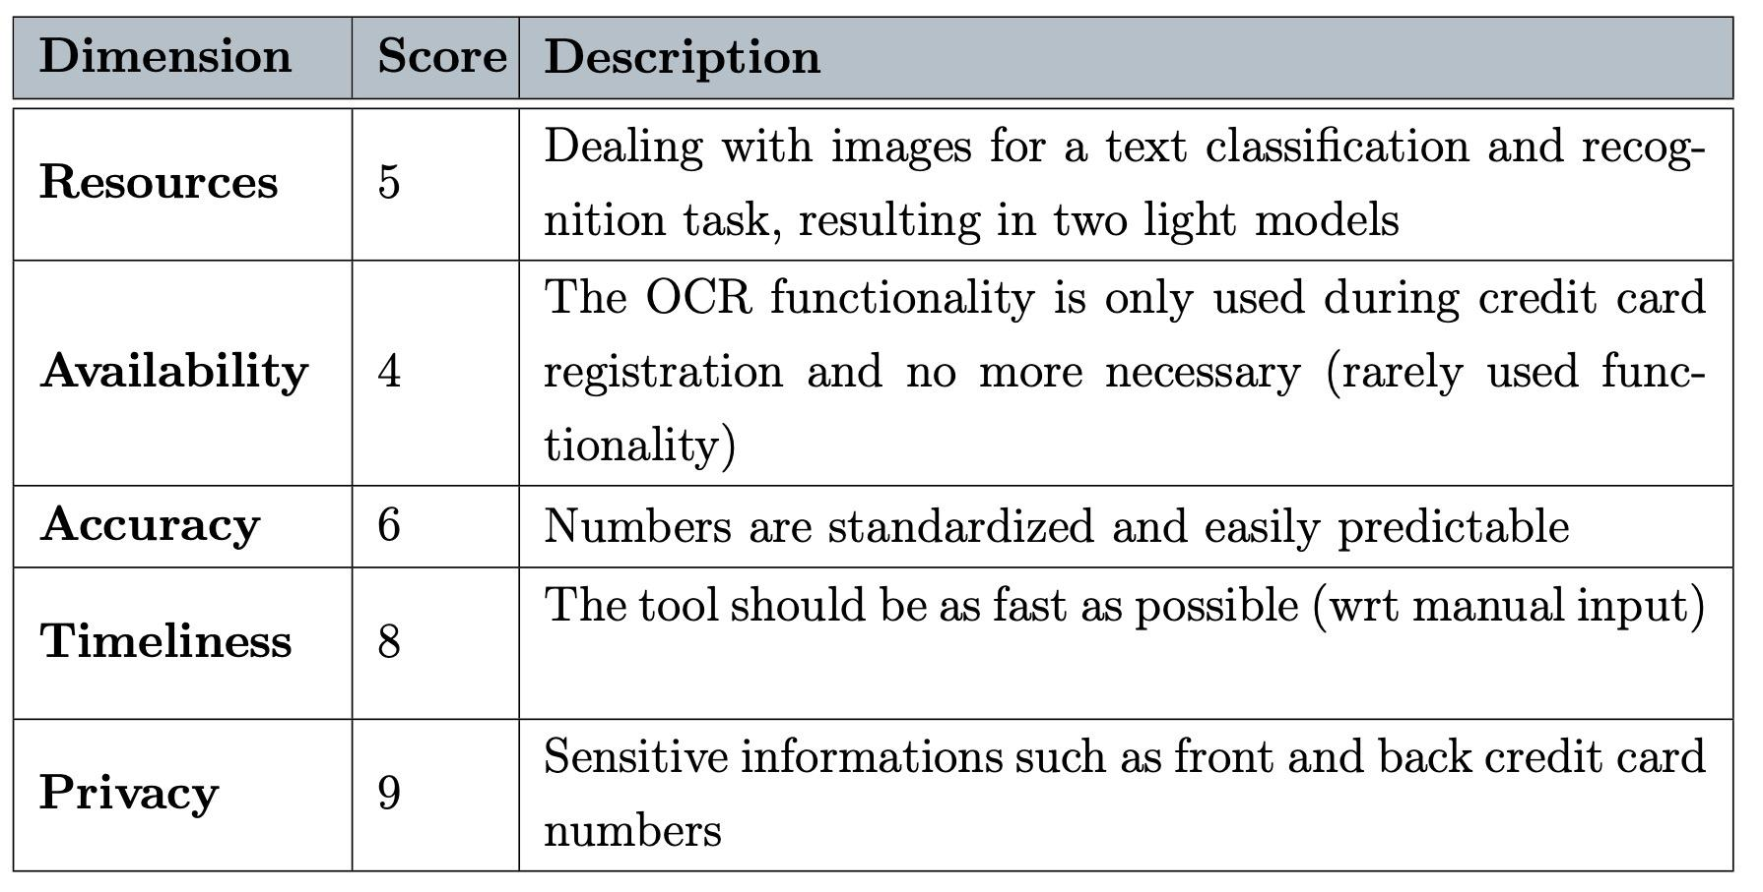

Use Case
Implementation of an OCR (Optical character recognition) for credit cards registration in a banking app: self-evaluation of the Scores
7

Slide 9
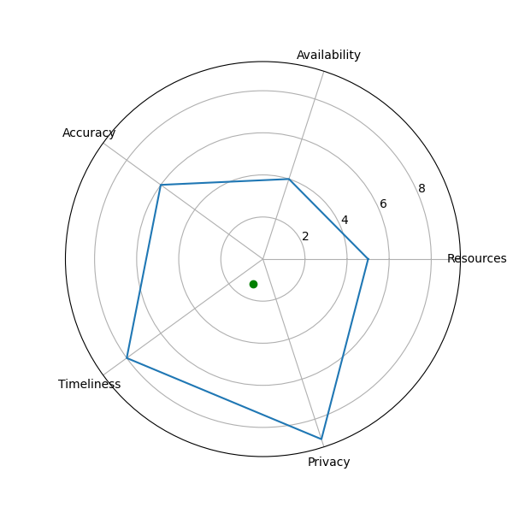
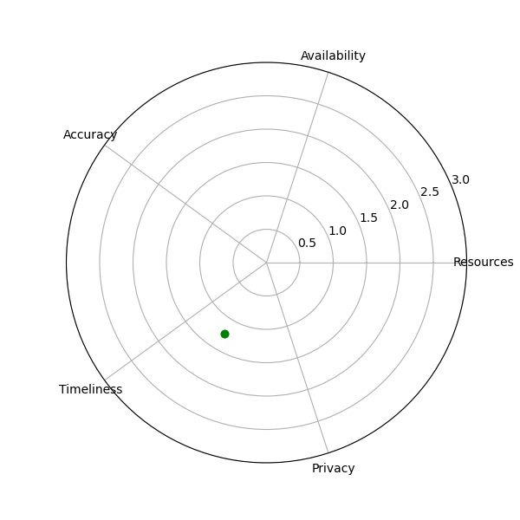
Use Case
Use Case Point
Zoomed centroid positioning
8

Slide 10
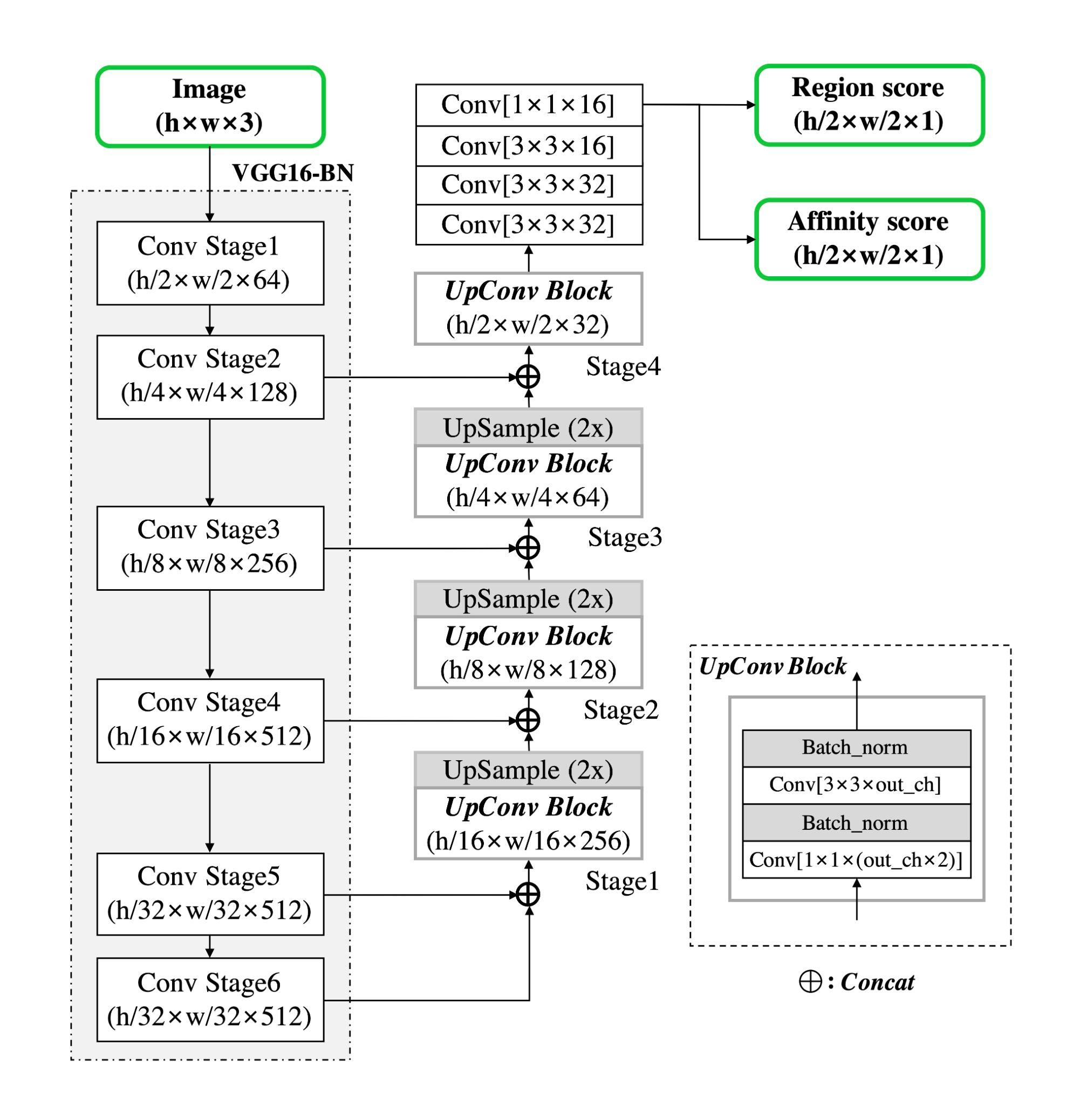
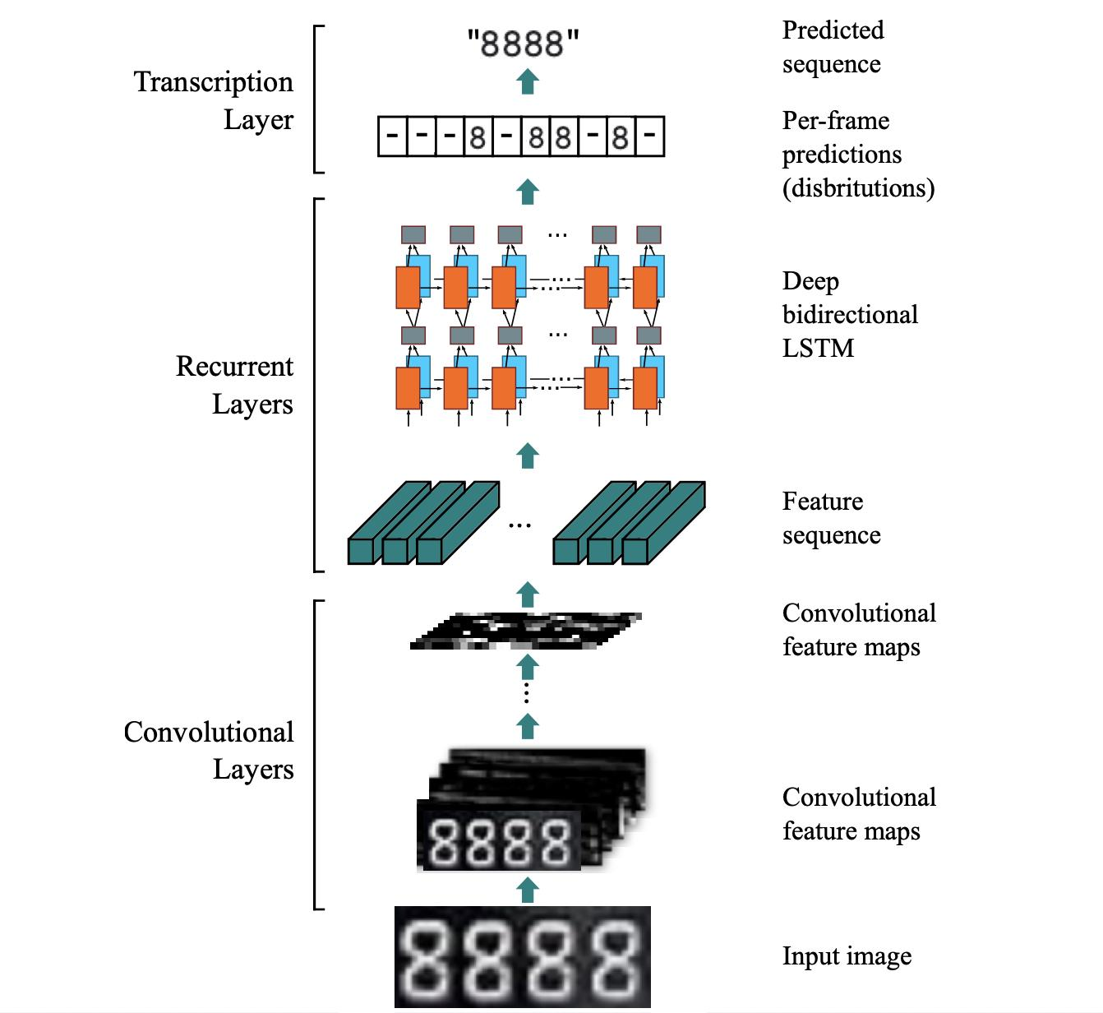
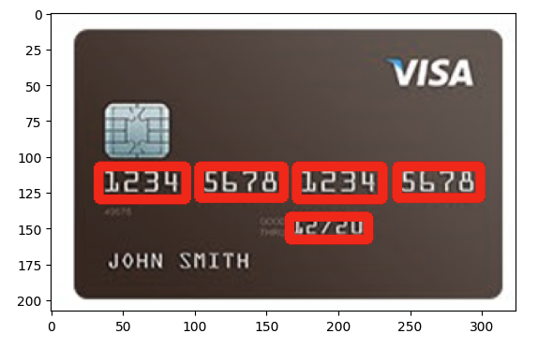
OCR Model
CRAFT Detector
RCNN Recognizer
9

Slide 11
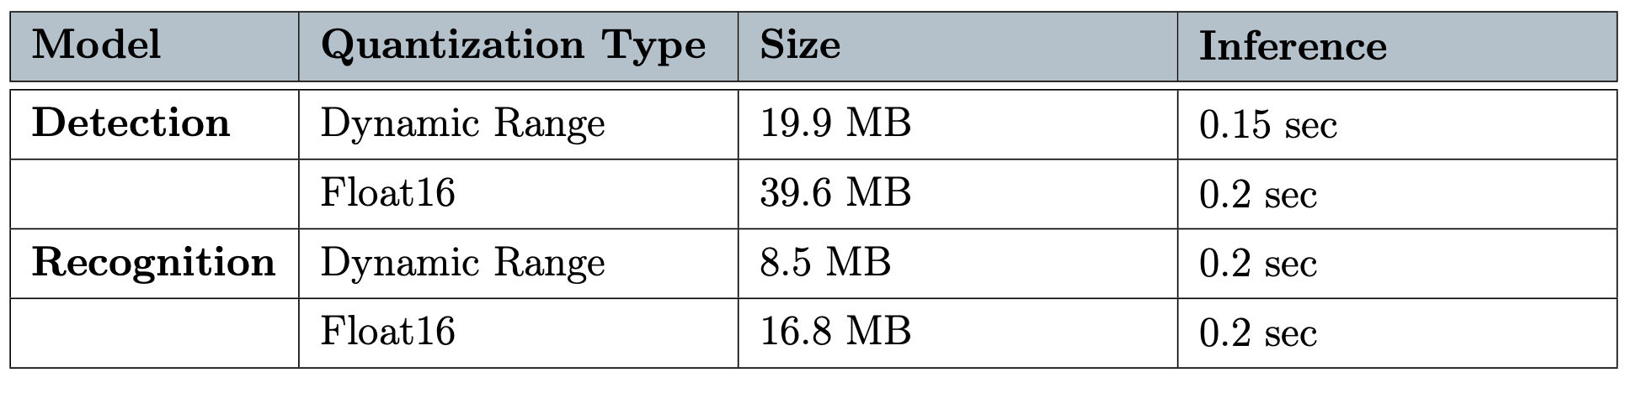
Considerations
An alternative design: Hybrid Deployment
Detection task performed locally
Recognition task offloaded, where the cropped detected text is locally pre-processed and then sent for offloading inference
10

Slide 12
Conclusions
This method is an aid but not a rule to follow
Other deployment variants should be investigated (especially the hybrid one)
Future Work
The Ethical dimension
Benchmarking
Dimensional Policy Approach
11

